Slide 1
The Outcome
Research Project

Slide 2
The Outcome
40% of the overall grade
RPB - 2000 words or 12 minutes multimodal
RPA – 1500 words or 10 minutes multimodal
Can combine the above i.e.
1,500 words and 3 minutes
1,000 words and 6 minutes
500 words and 9 minutes

Slide 3
Performance Standards What do they mean?
S1 - Synthesis of knowledge, skills, and ideas to produce a resolution to the research question.
‘Synthesis’ means bring everything together.
Expand on and explain your key findings (and other relevant findings) from your Folio to answer your research question.
How well do you answer your research question?
Does it suit your target audience?
If you find that your findings are not answering your question, refine your question to suit.

Slide 4
Performance Standards What do they mean?
S2 - Insightful and thorough substantiation of key findings relevant to the Research Outcome.
‘Substantiation’ means backing up/referencing
You need to substantiate/reference your Outcome with the sources you found from your folio – there will be a lot!
Try and use as many sources as possible for this – it shows thorough and insightful substantiation
Footnoting or endnoting only – no in-text referencing
Need to think about the format as to which one you use
Make sure the referencing has numbers, not roman numerals
Need to reference images used too

Slide 5
Performance Standards What do they mean?
S3 - Clear and coherent expression of ideas.
All about the format you choose i.e. looks and sounds like your chosen format.
Is the format appropriate for your question?
Is it written and presented appropriately for your chosen format?
Spelling, grammar, appearance etc.

Slide 6
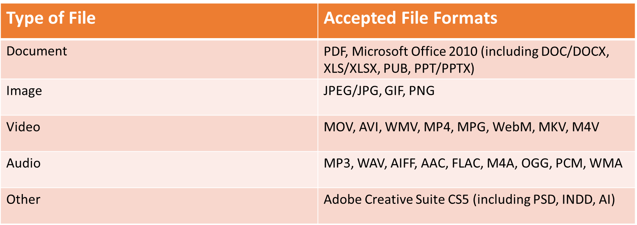
Acceptable formats of files to SACE website

Slide 7
Due dates
Draft of Outcome due no later than Friday Week 1 Term 4 (15th October) – this is your holiday homework

Slide 8
Tasks for week 10
Continue with your Outcome plan document
Continue looking at exemplars of past Outcomes on the weebly site
Continue looking at format examples to help you i.e. if doing a website, look at different websites etc.
Once ready and have spoken to Mrs C, start your Outcome draft

